Slide 1

Visualizing Uncertainty
Modeling Uncertainty in the Earth Sciences
Jef Caers
Stanford University

Slide 2
Managing uncertainty
How can we “visualize” so many Earth models and get better insight in the uncertainty they represent?
How can we start including the purpose of modeling into this representation of uncertainty?

Slide 3
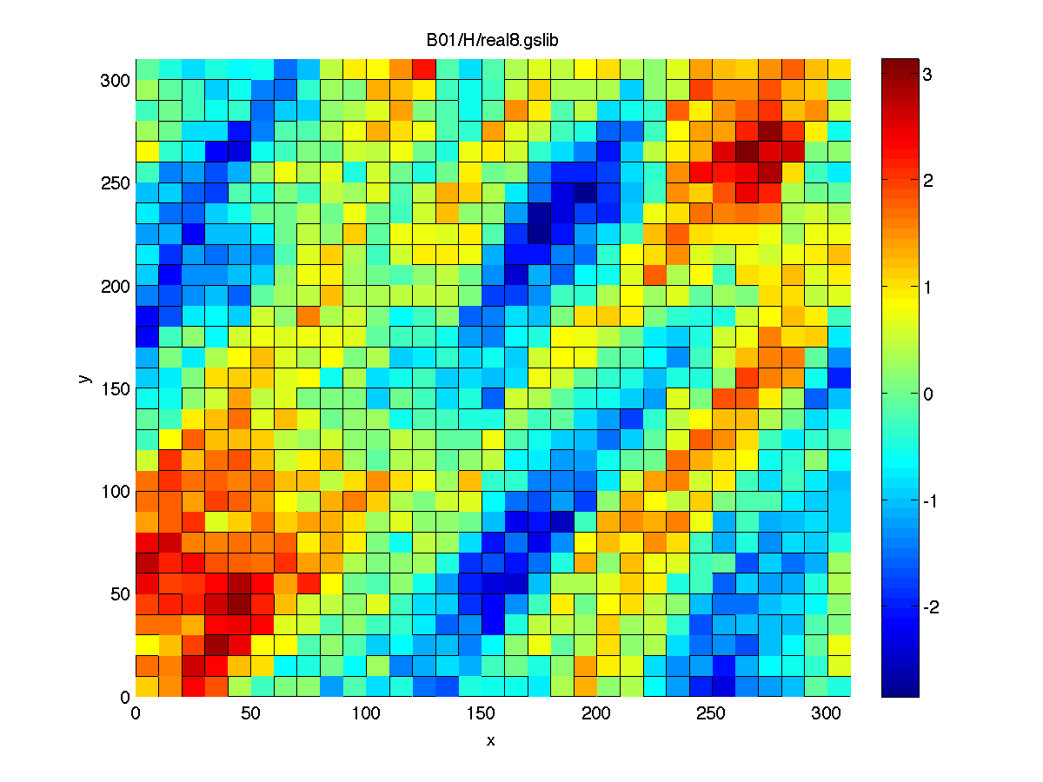
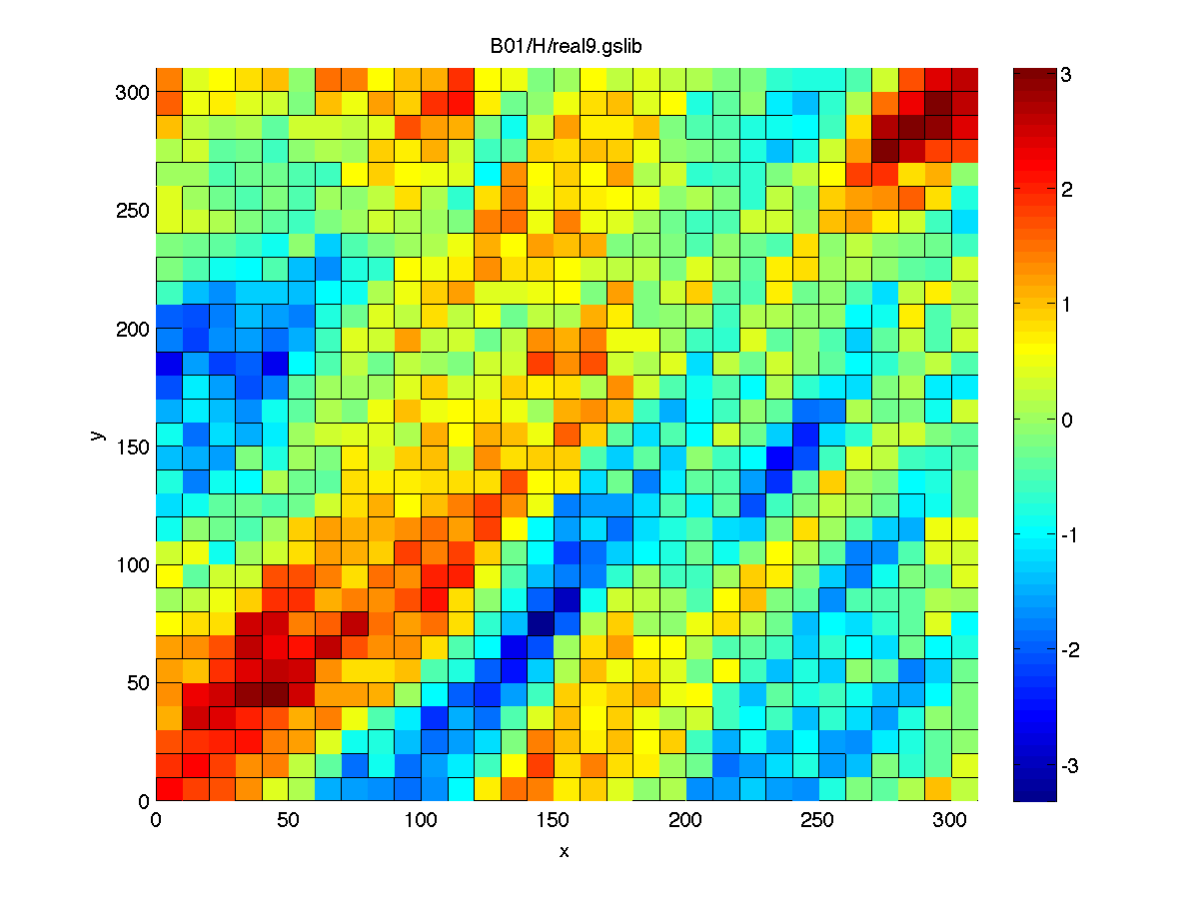
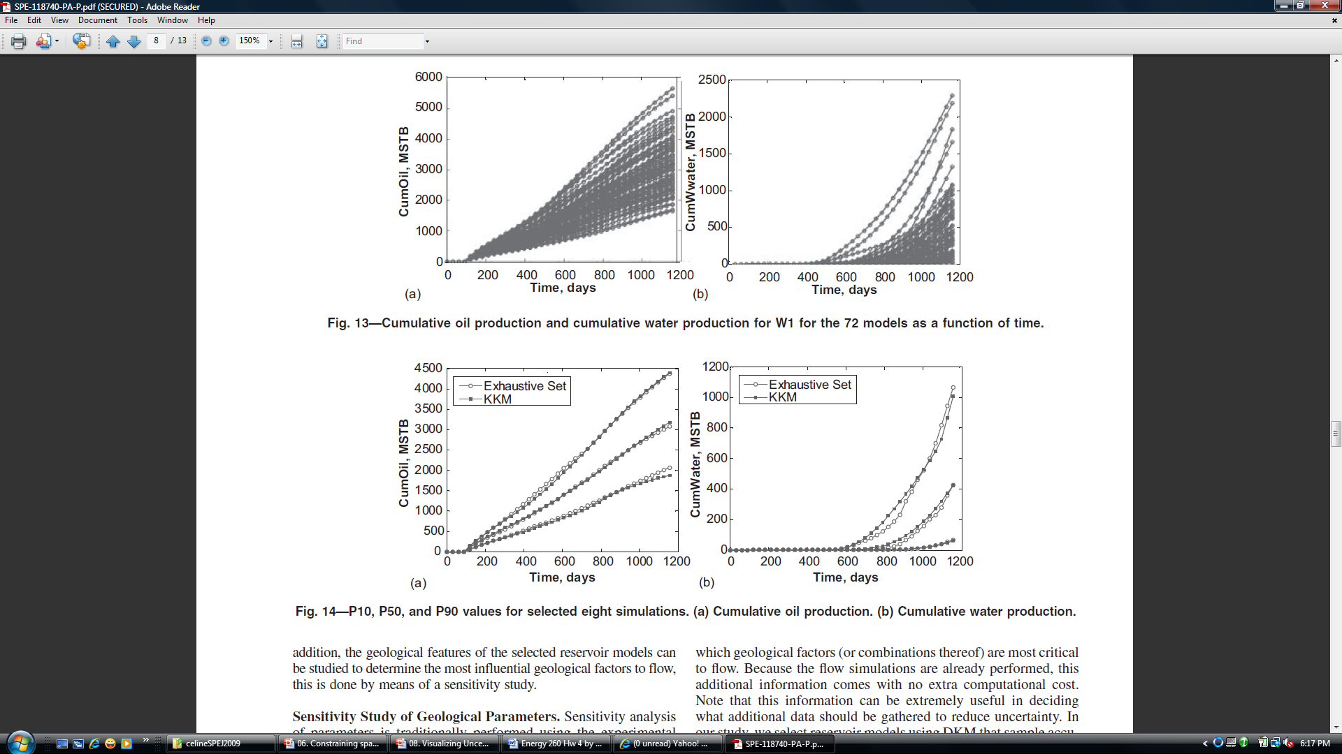
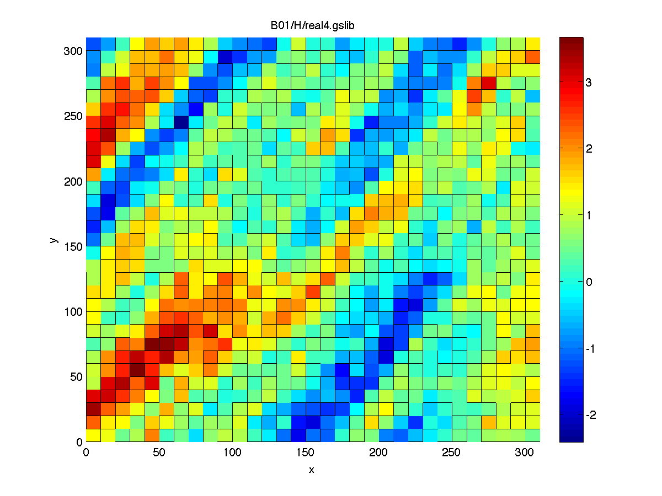
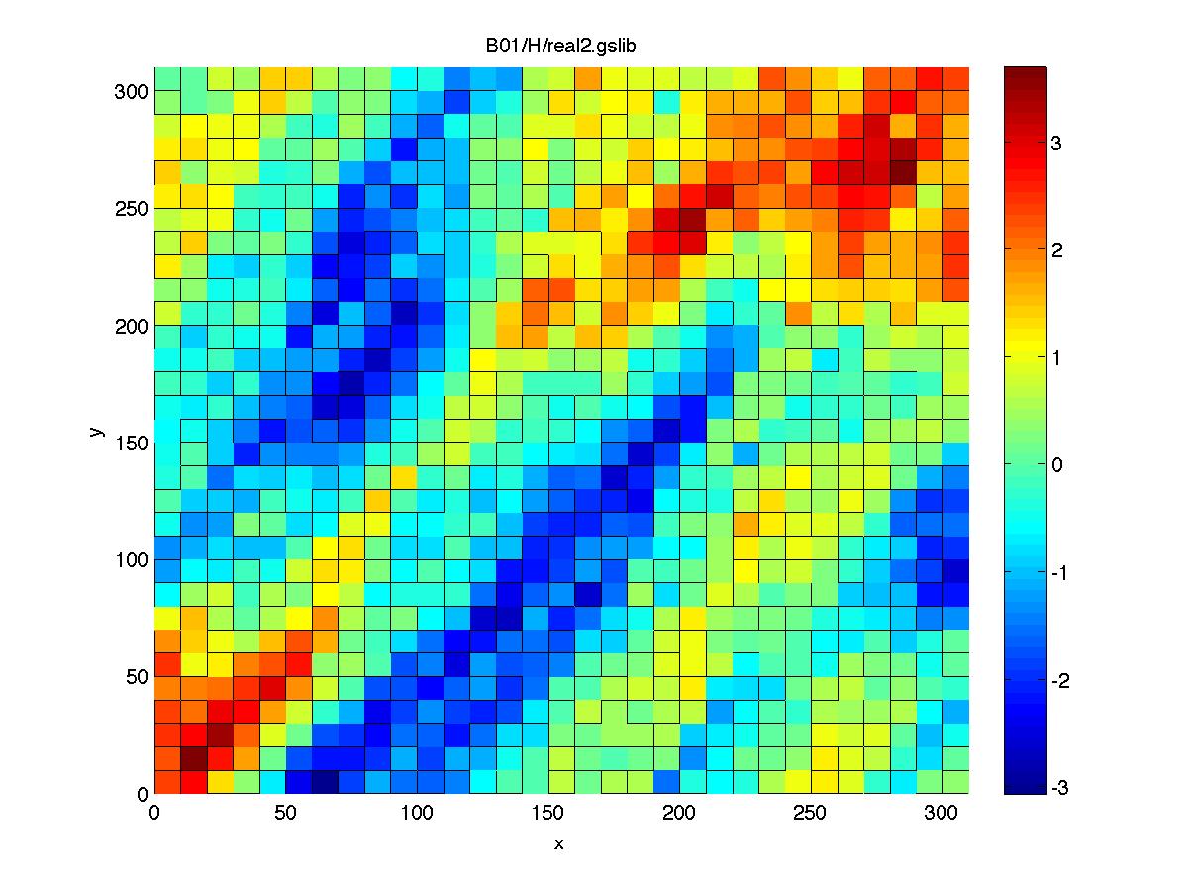
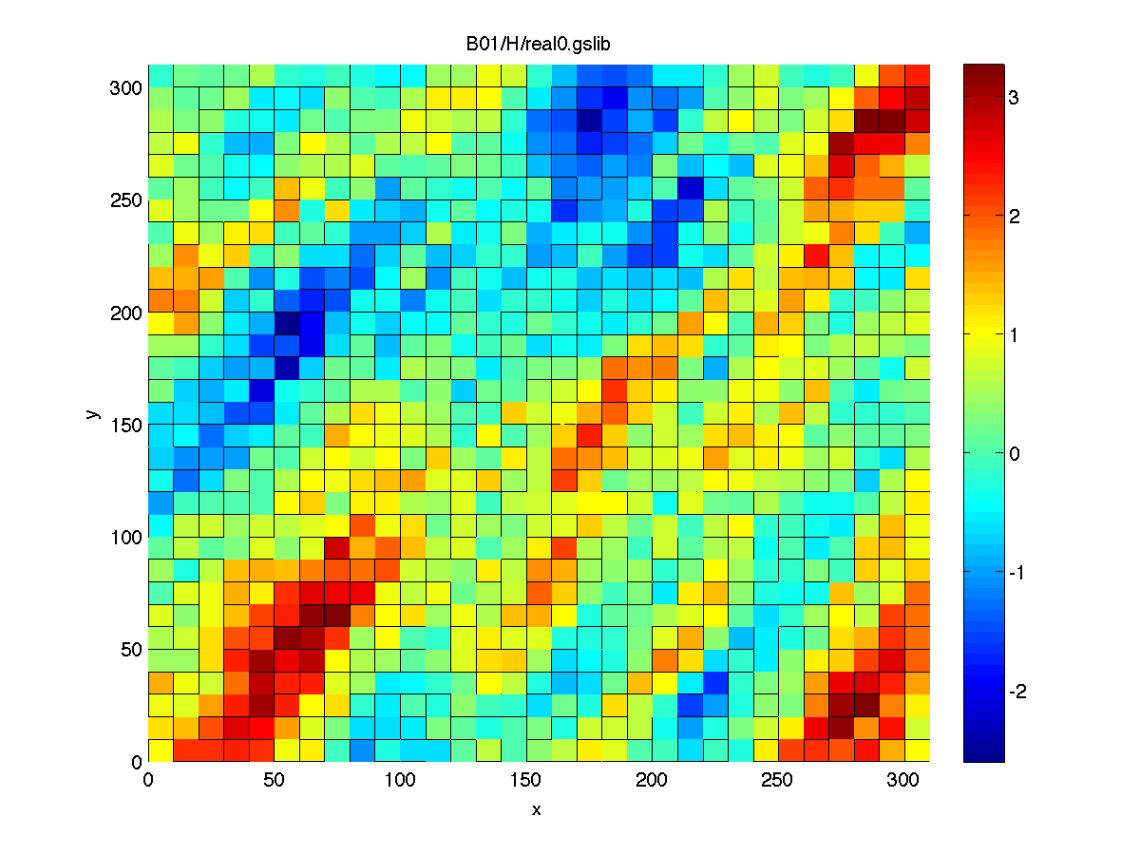
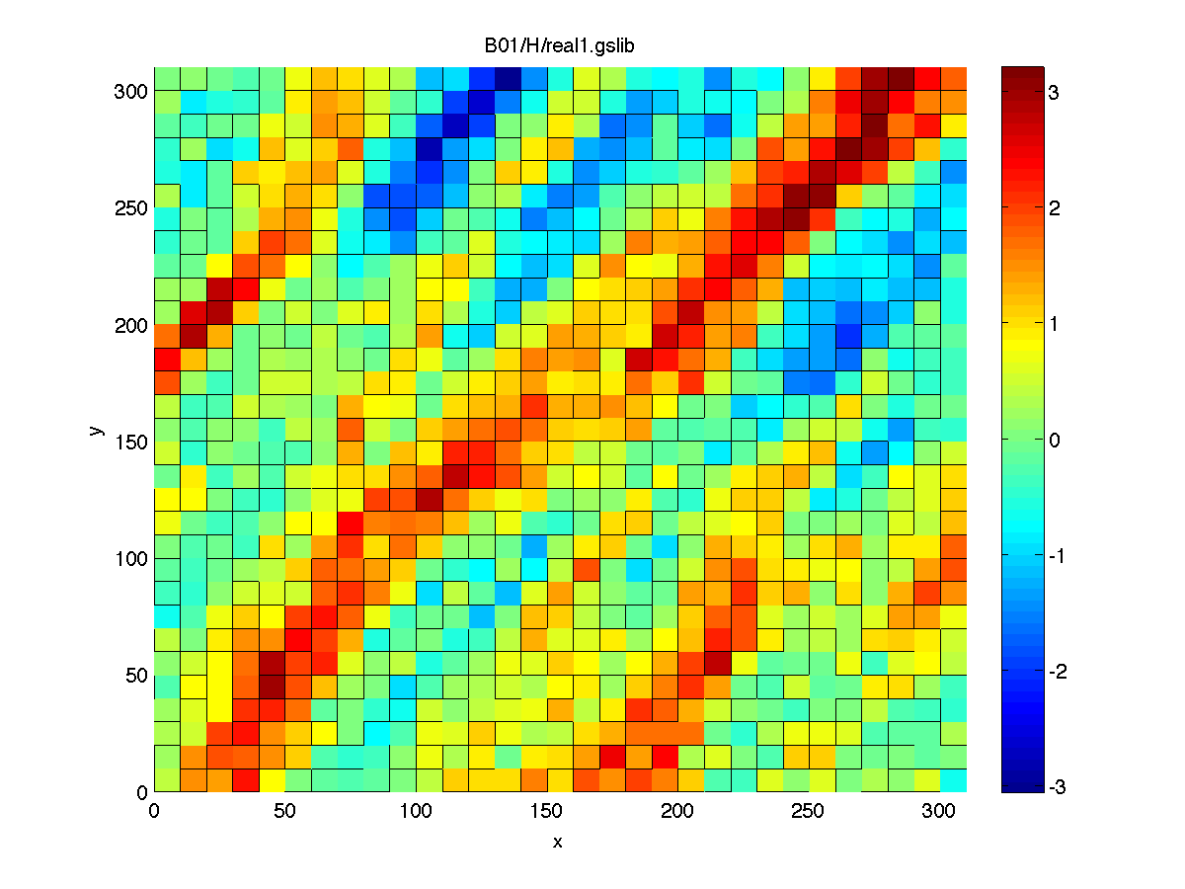
Response uncertainty
Exhaustive flow simulation
to calculate Oil/Water production
P90
P90
P50
P50
P10
P10
Location of wells

Slide 4
Modeling uncertainty in the Earth Sciences
High dimensional
Low dimensional

Slide 5
Multi-dimensional scaling (MDS)
Simple version:
if you have the pair-wide distance between L cities (distance table),
then,
you can uniquely map these cities on a 2D map up to rotation, reflection and translation

Slide 6
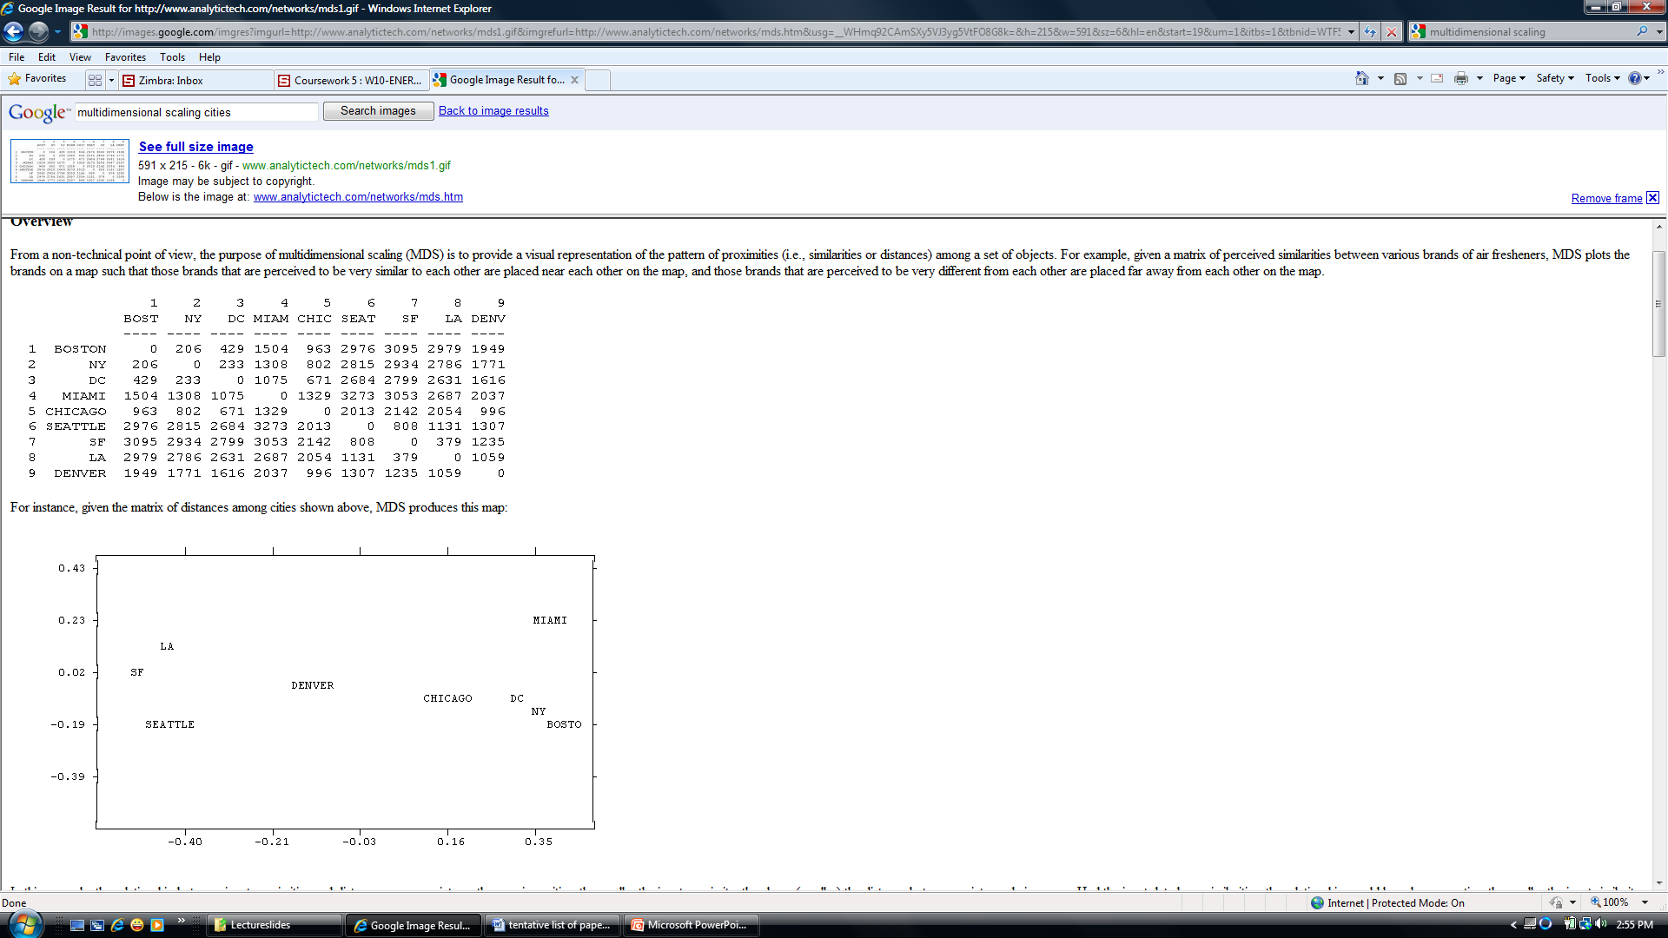
Example
MDS

Slide 7
Multi-dimensional scaling (MDS)
Extension:
given the pairwise distance between a set of L Earth models,
⇒ you can uniquely map these models in any dimension less or equal to L
(up to rotation, reflection and translation)

Slide 8
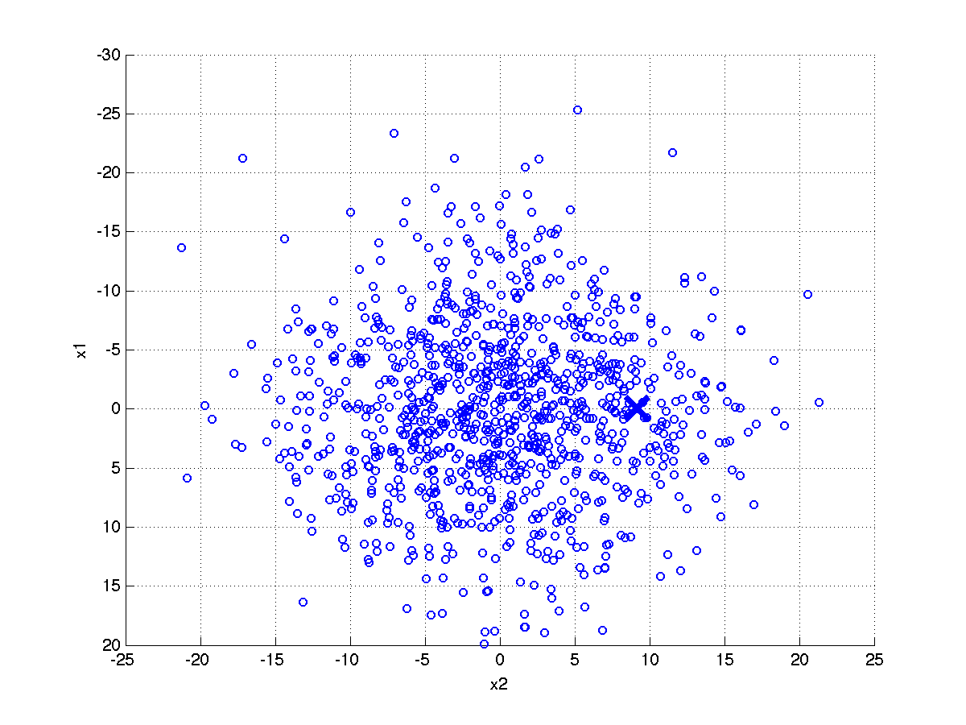
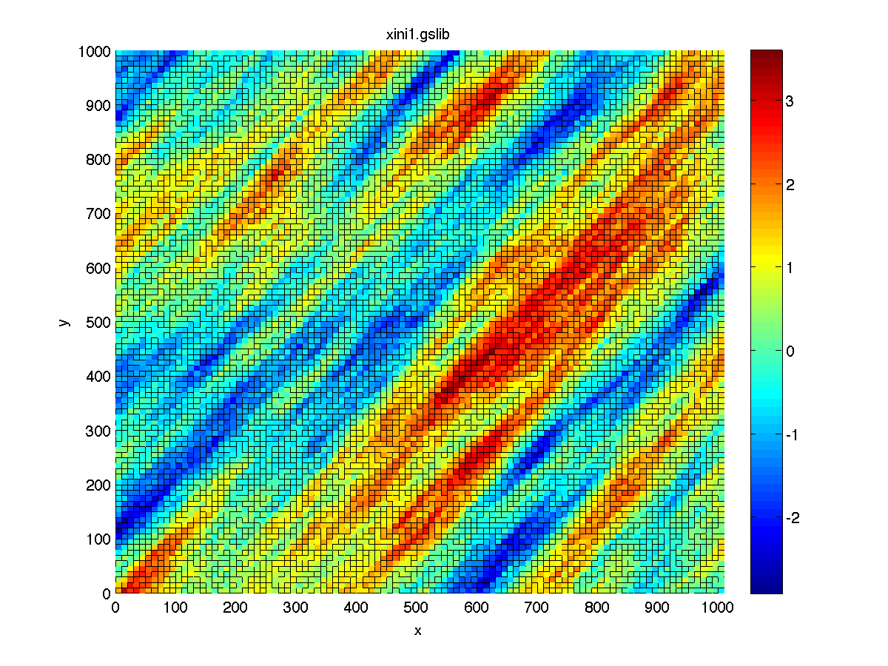
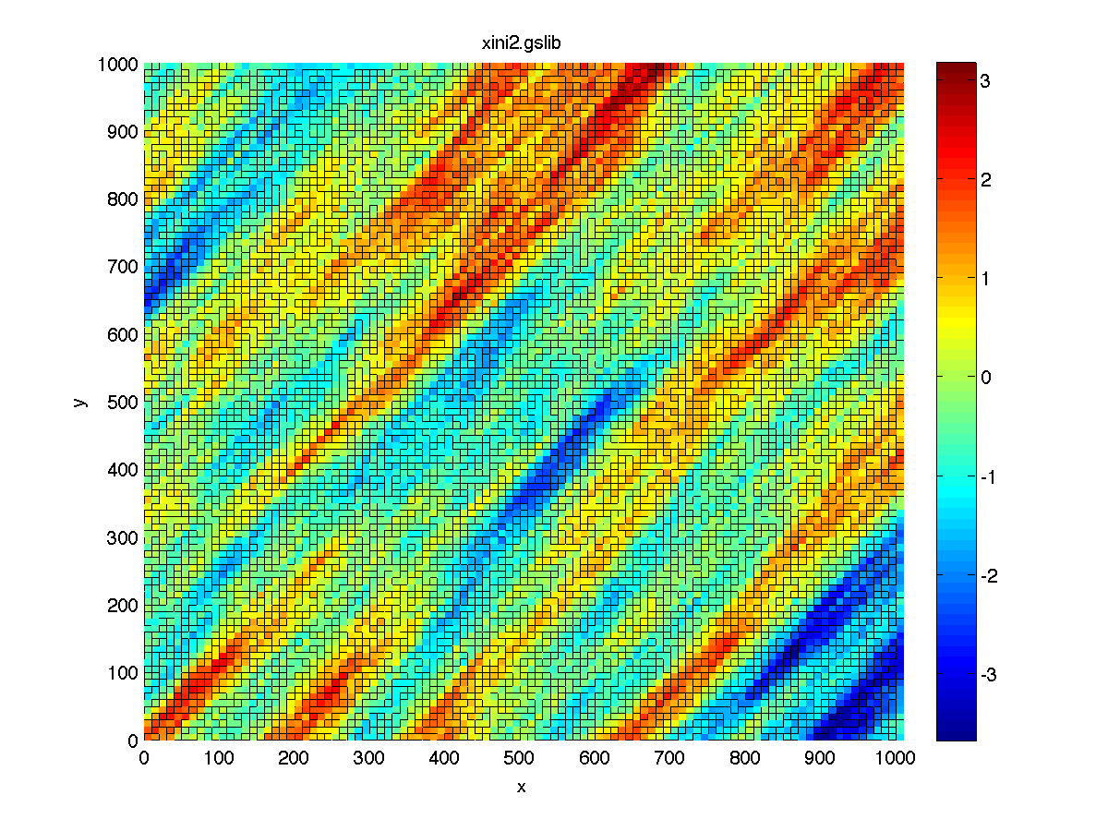
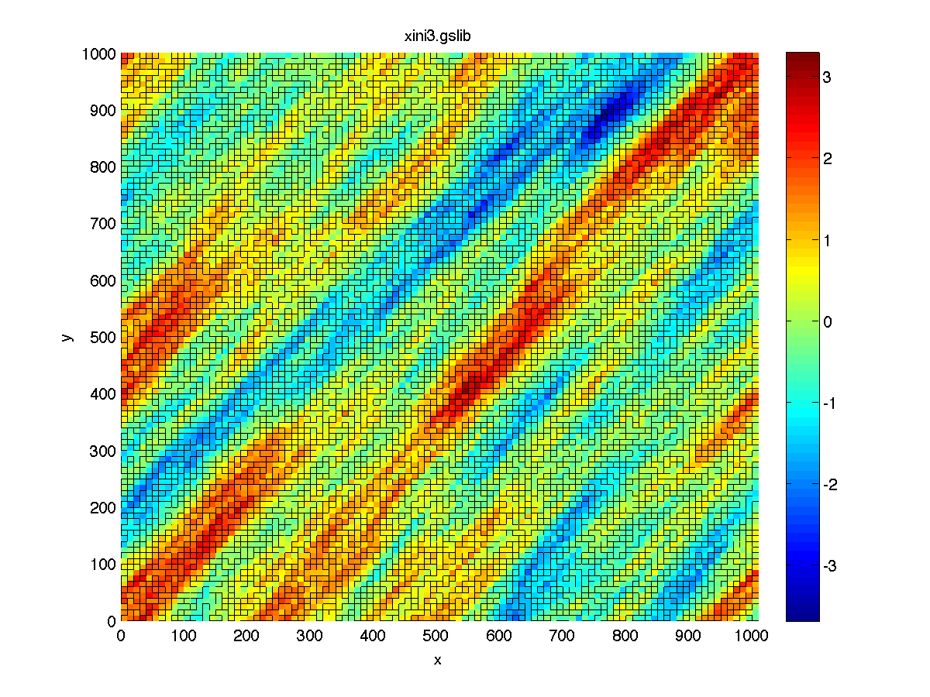
Distances: multi-dimensional scaling
1000 SGSIM model
2D map of Earth models:
explicit visualization of uncertainty
Calculate Euclidean distance

Slide 9
MDS theory
x_{j}
d_{jk}
d_{ij}
x_{k}
x_{i}
d_{ik}

Slide 10
MDS: matrix theory
Note: theory formulated for
Euclidean distance but can be applied
to any distance

Slide 11
MDS summary

Slide 12
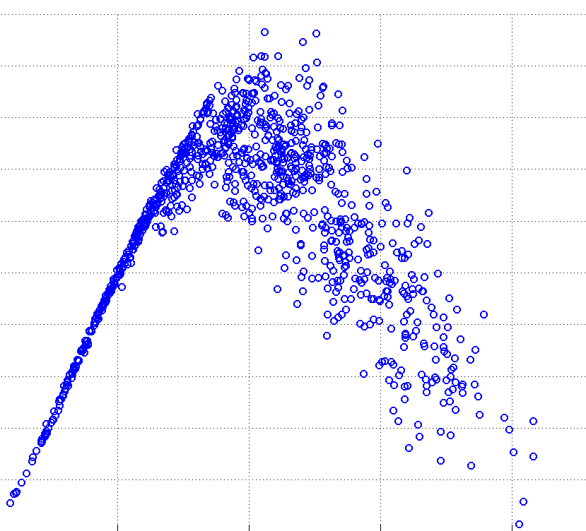
Application-tailored distance
1000 Gaussian models
2D map of models
Drinking well
Pollution source
Calculate a “connectivity” distance

Slide 13
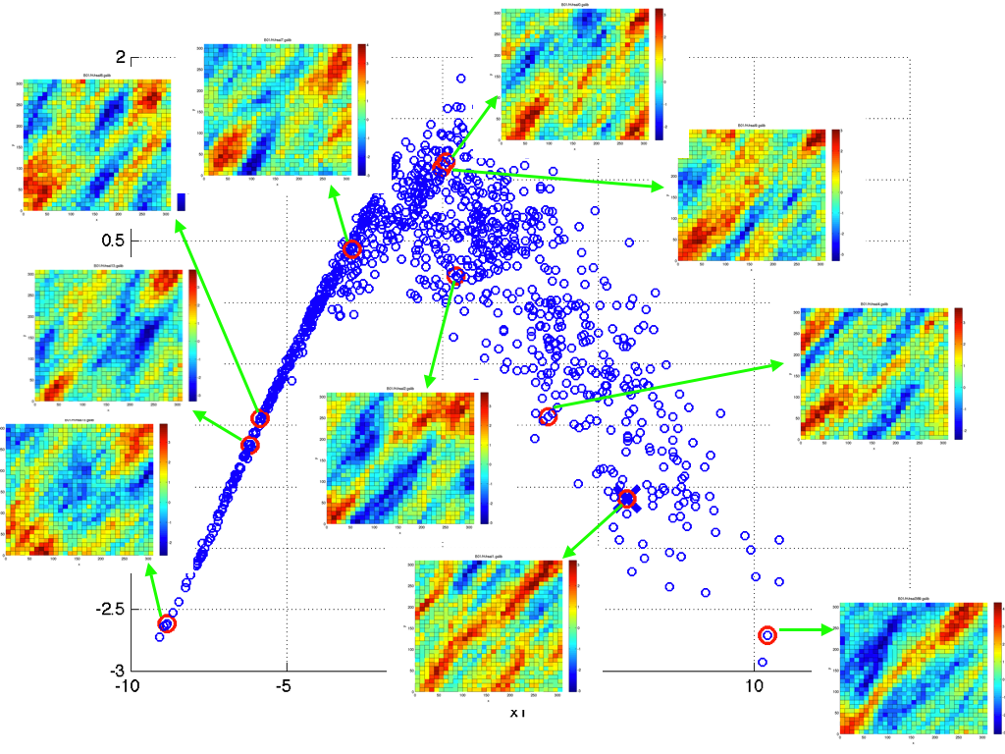
Proper choice of distance leads to purpose-driven
organization of models

Slide 14
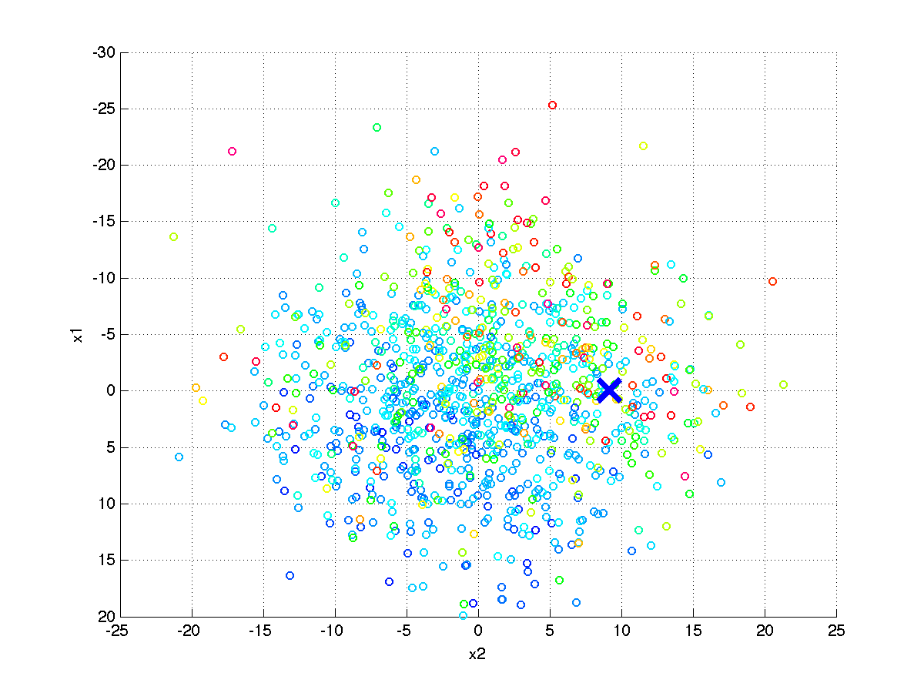
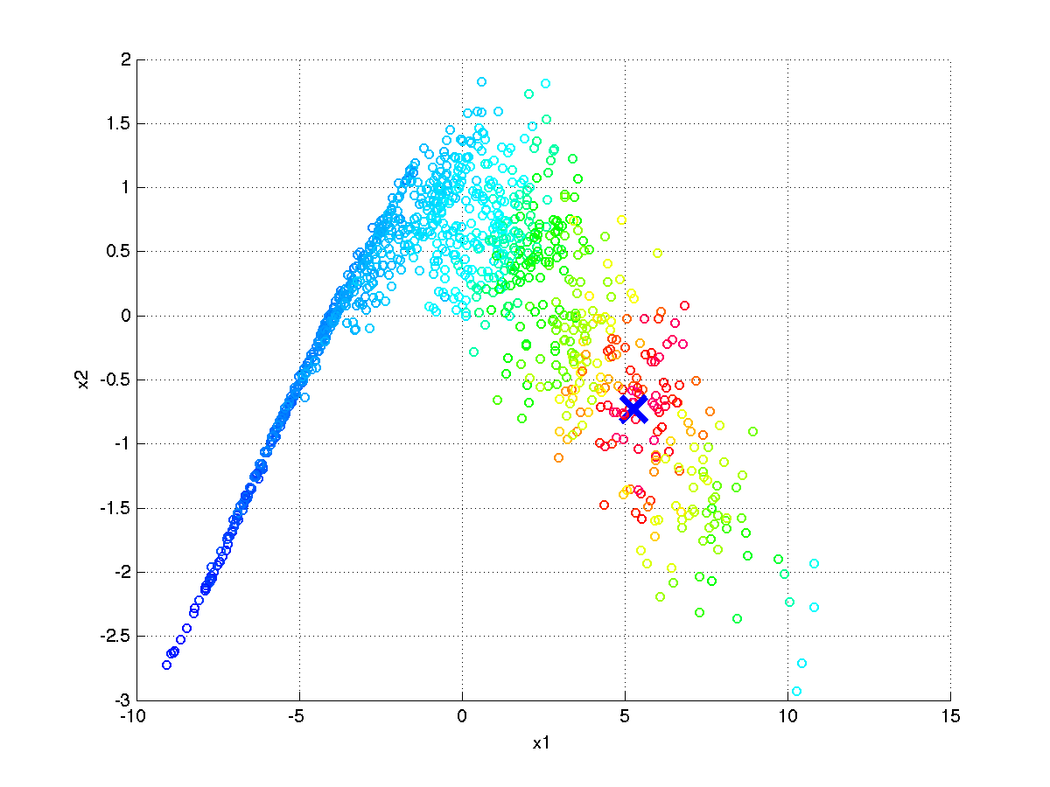
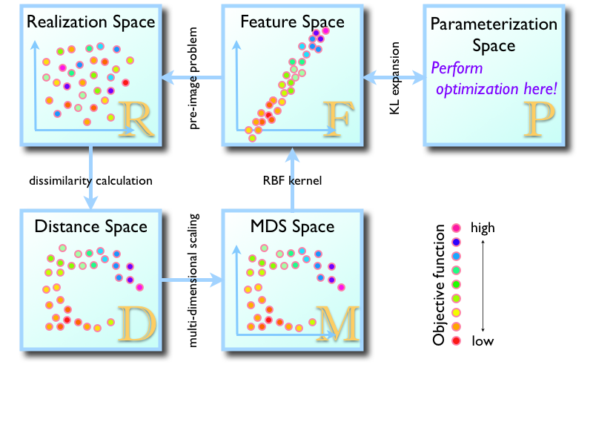
Importance of purpose-driven metric
Euclidean distance
Connectivity distance
Color indicates amount of contaminant in pumping well

Slide 15
Another example

Slide 17
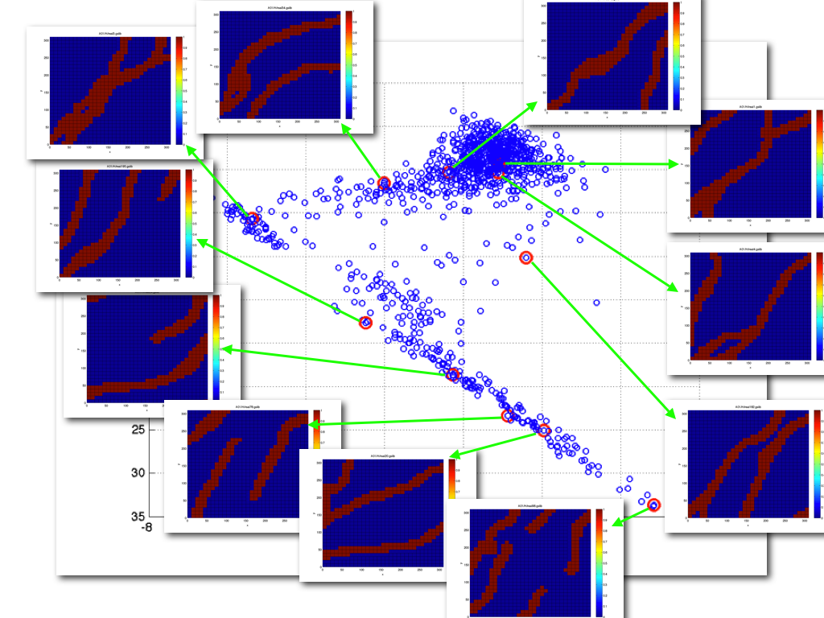
Determining the dimension

Slide 18
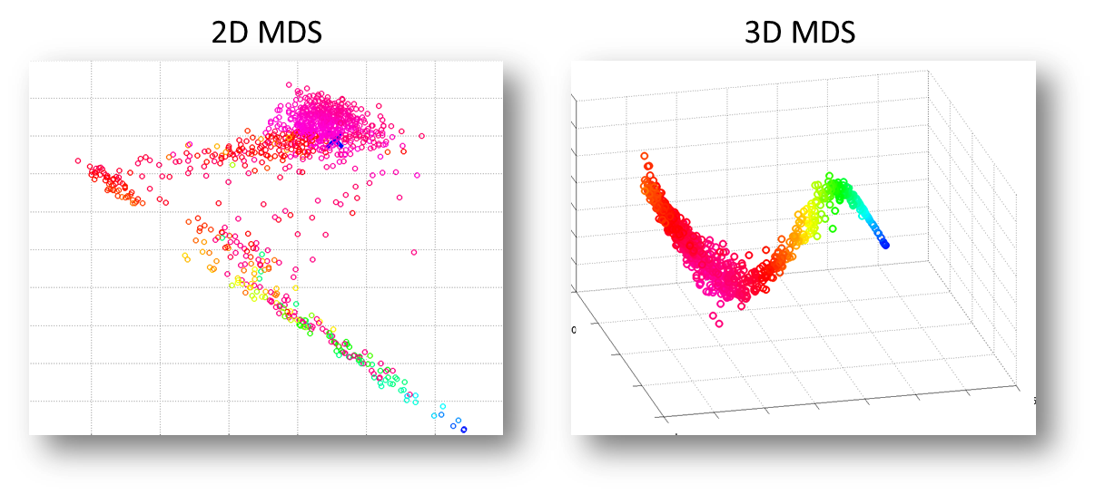
2D, 3D or …. which D ?

Slide 19
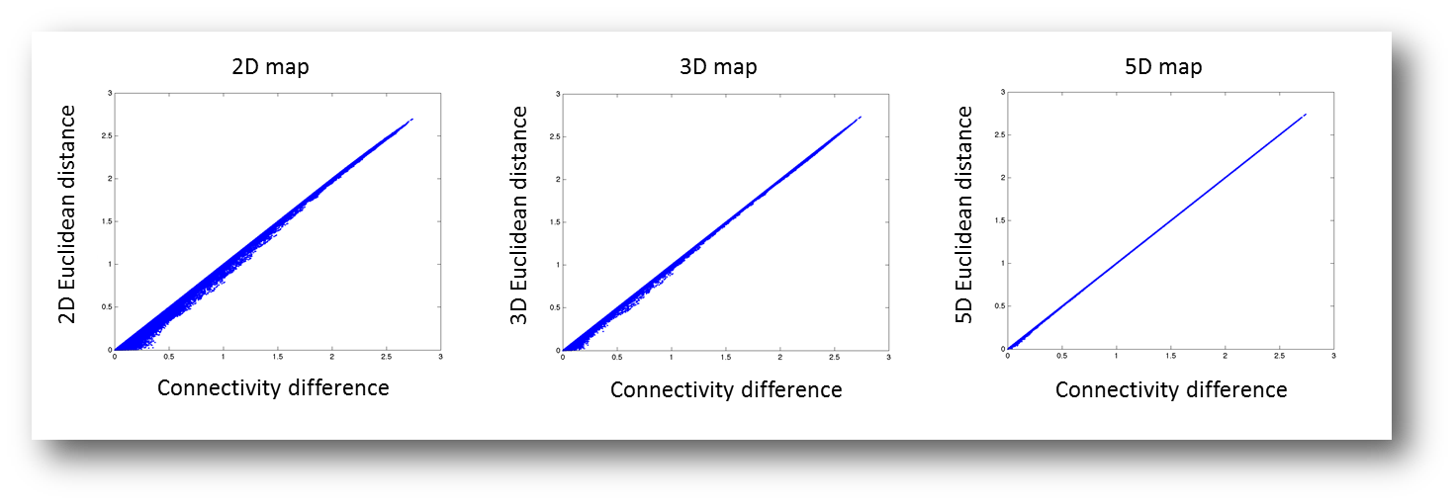
Correlations

Slide 20
Linear separation
?
Perfect separation is not possible

Slide 21
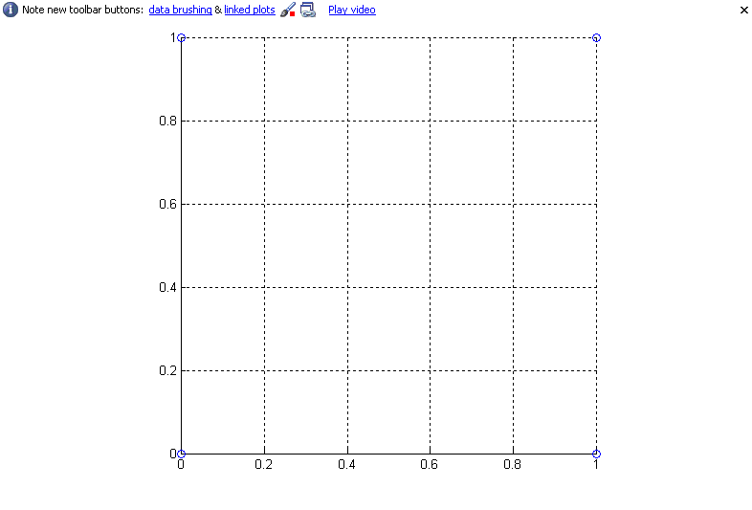
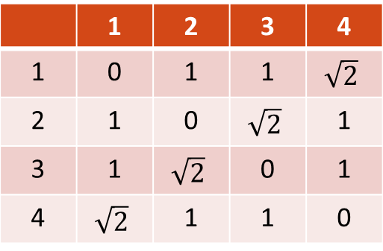
Linear separation: simple problem
3
4
distance
 | 1 | 2 | 3 | 4
1 | 0 | 1 | 1 | $$\sqrt{2}$$
2 | 1 | 0 | $$\sqrt{2}$$ | 1
3 | 1 | $$\sqrt{2}$$ | 0 | 1
4 | $$\sqrt{2}$$ | 1 | 1 | 0
1
2

Slide 22
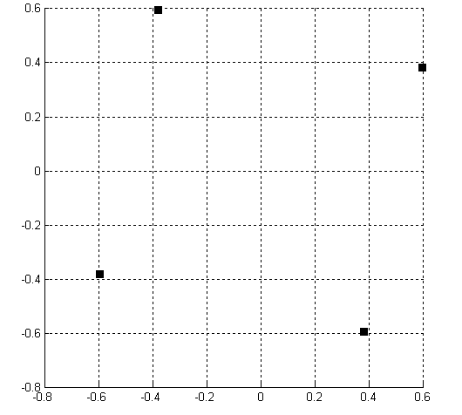
MDS: doesn’t solve the problem
3
4
Two non-zero eigenvalues
λ₁ = λ₂ = 1
λ₃ = λ₄ = 0
1
2

Slide 23
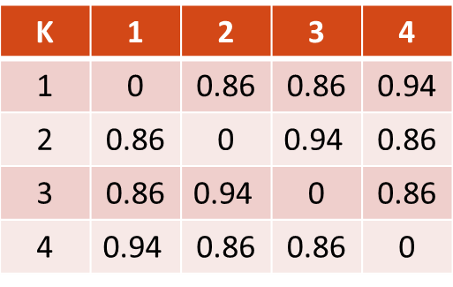
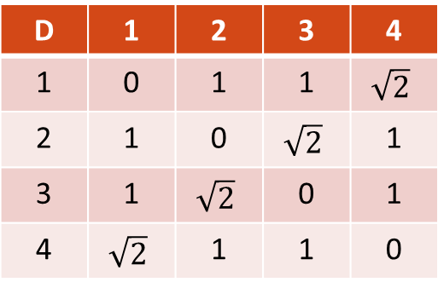
Do a simple transformation
distance
new distance
D | 1 | 2 | 3 | 4
1 | 0 | 1 | 1 | $$\sqrt{2}$$
2 | 1 | 0 | $$\sqrt{2}$$ | 1
3 | 1 | $$\sqrt{2}$$ | 0 | 1
4 | $$\sqrt{2}$$ | 1 | 1 | 0
K | 1 | 2 | 3 | 4
1 | 0 | 0.86 | 0.86 | 0.94
2 | 0.86 | 0 | $$\text{0.94}$$ | 0.86
3 | 0.86 | $$\text{0.94}$$ | 0 | 0.86
4 | $$\text{0.94}$$ | 0.86 | 0.86 | 0
k= 1-exp(-d)
λ₁ = λ₂ = 1
λ₃ = λ₄ = 0
λ₁ = λ₂ = 0.44
λ₃ = 0.31
λ₄ = 0

Slide 24
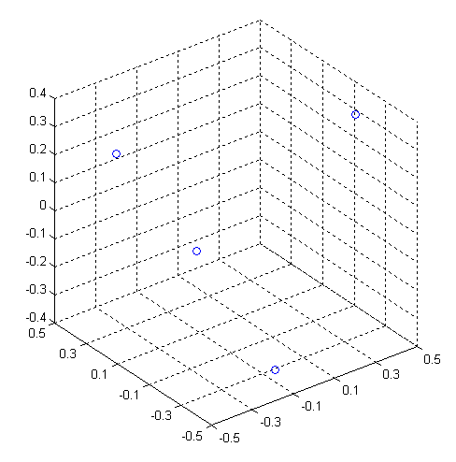
Linear separation is possible
4
1
3
2

Slide 25
Transformation
x₂
x₁

Slide 26
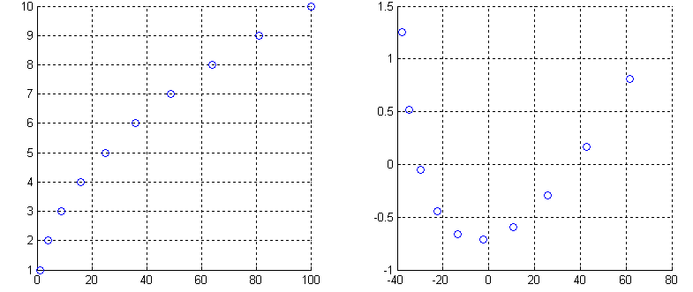
Distance-based transformation
“Model space”
Mapping with MDS
x₂
x₁
Calculate Euclidean distance

Slide 27
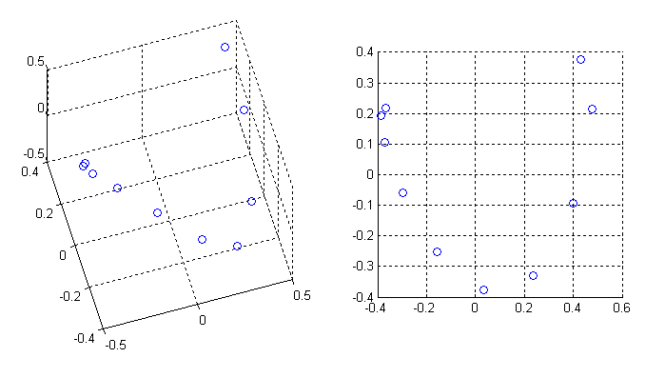
Distance-based transformation
3D
2D
In fact matrix K has 9 positive eigenvalues

Slide 28
Kernel transformation
Transformation from one metric space to another does not
require knowledge of ϕ, only knowledge of the dot-product ϕ^{T} ϕ
Euclidean distance
obtained with MDS
Role of the Kernel
Increase dimension, seperability and linearity

Slide 29
Metric
Space on x
Feature
Space on x
ϕ
No Axis defined
ϕ⁻¹
No Axis defined
MDS
MDS
Kernels are a mathematical tool to map between metric spaces

Slide 30
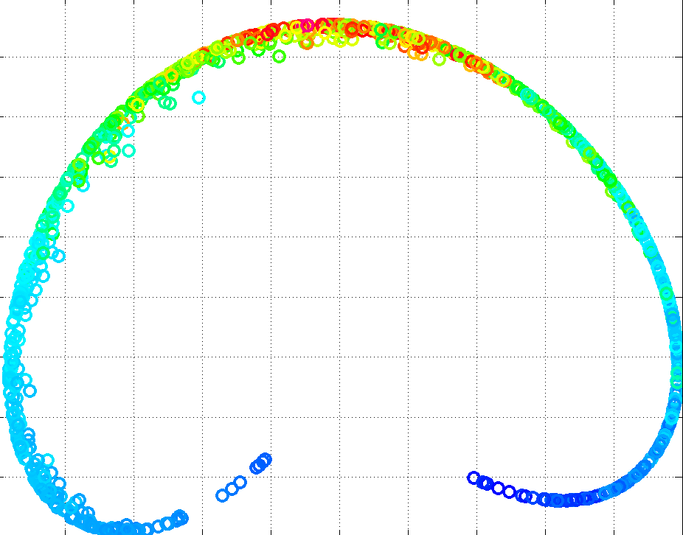
Kernel transformation
2D projection of models
From metric space
2D projection of models
in feature space
RBF Kernel
Making the map nicer and easier to work with

